Slide 1
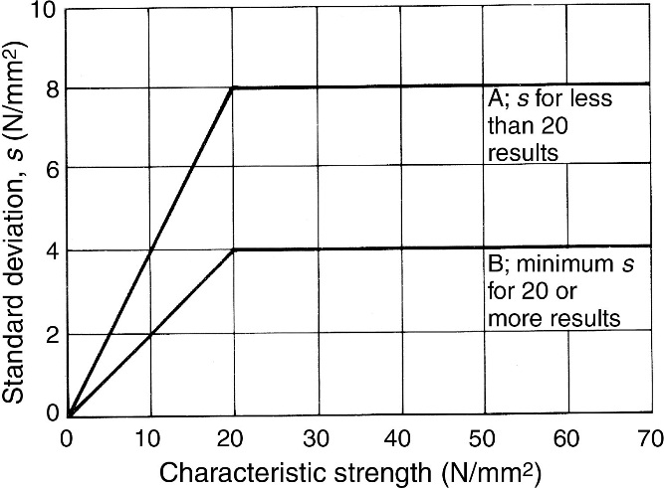
FIGURE 21.1 Assumed Relationship Between Standard Deviation and Strength

Slide 2
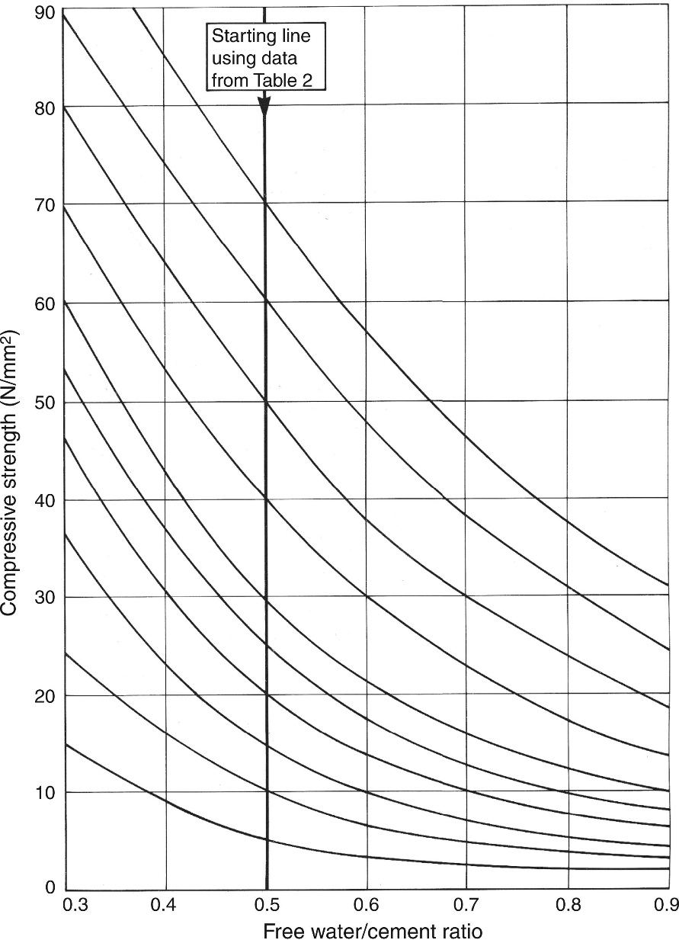
FIGURE 21.2 Relationship Between Strength and w/c Ratio

Slide 3
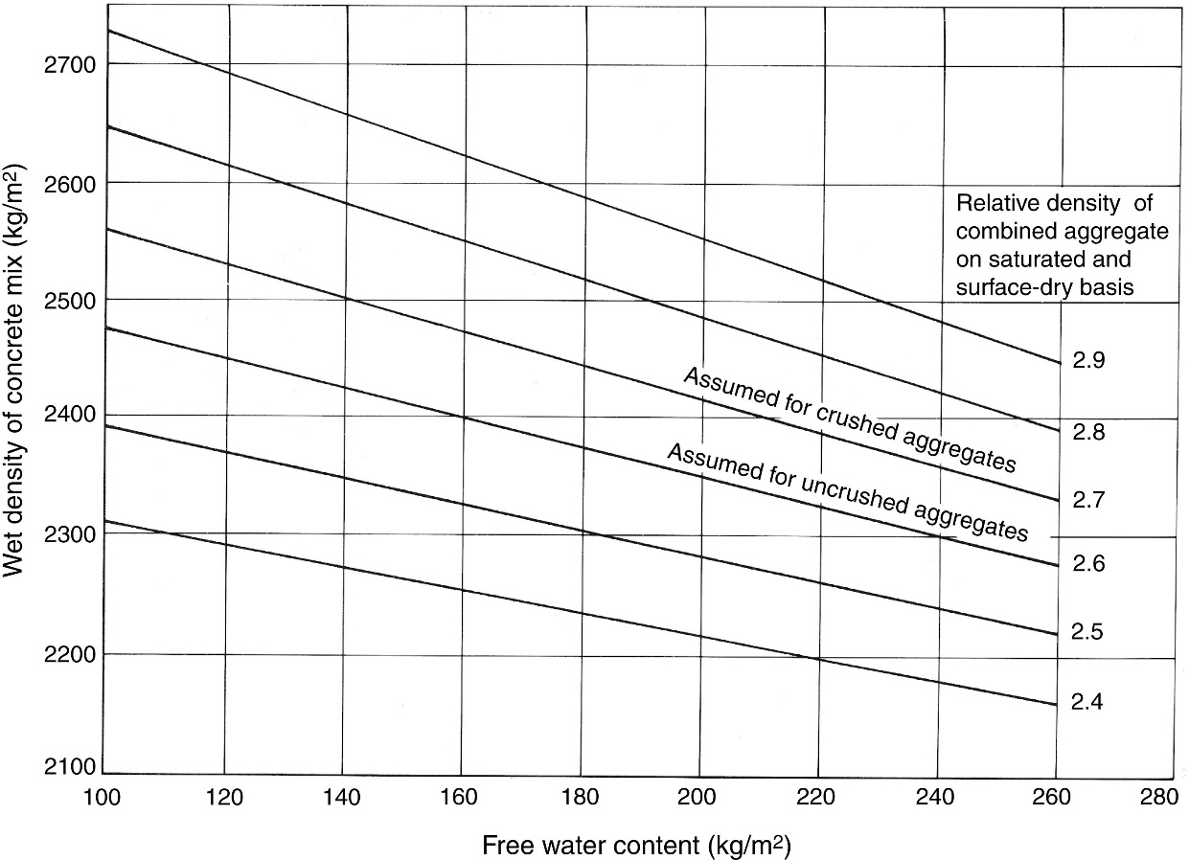
FIGURE 21.3 Relationship Between Density and Water Content

Slide 4
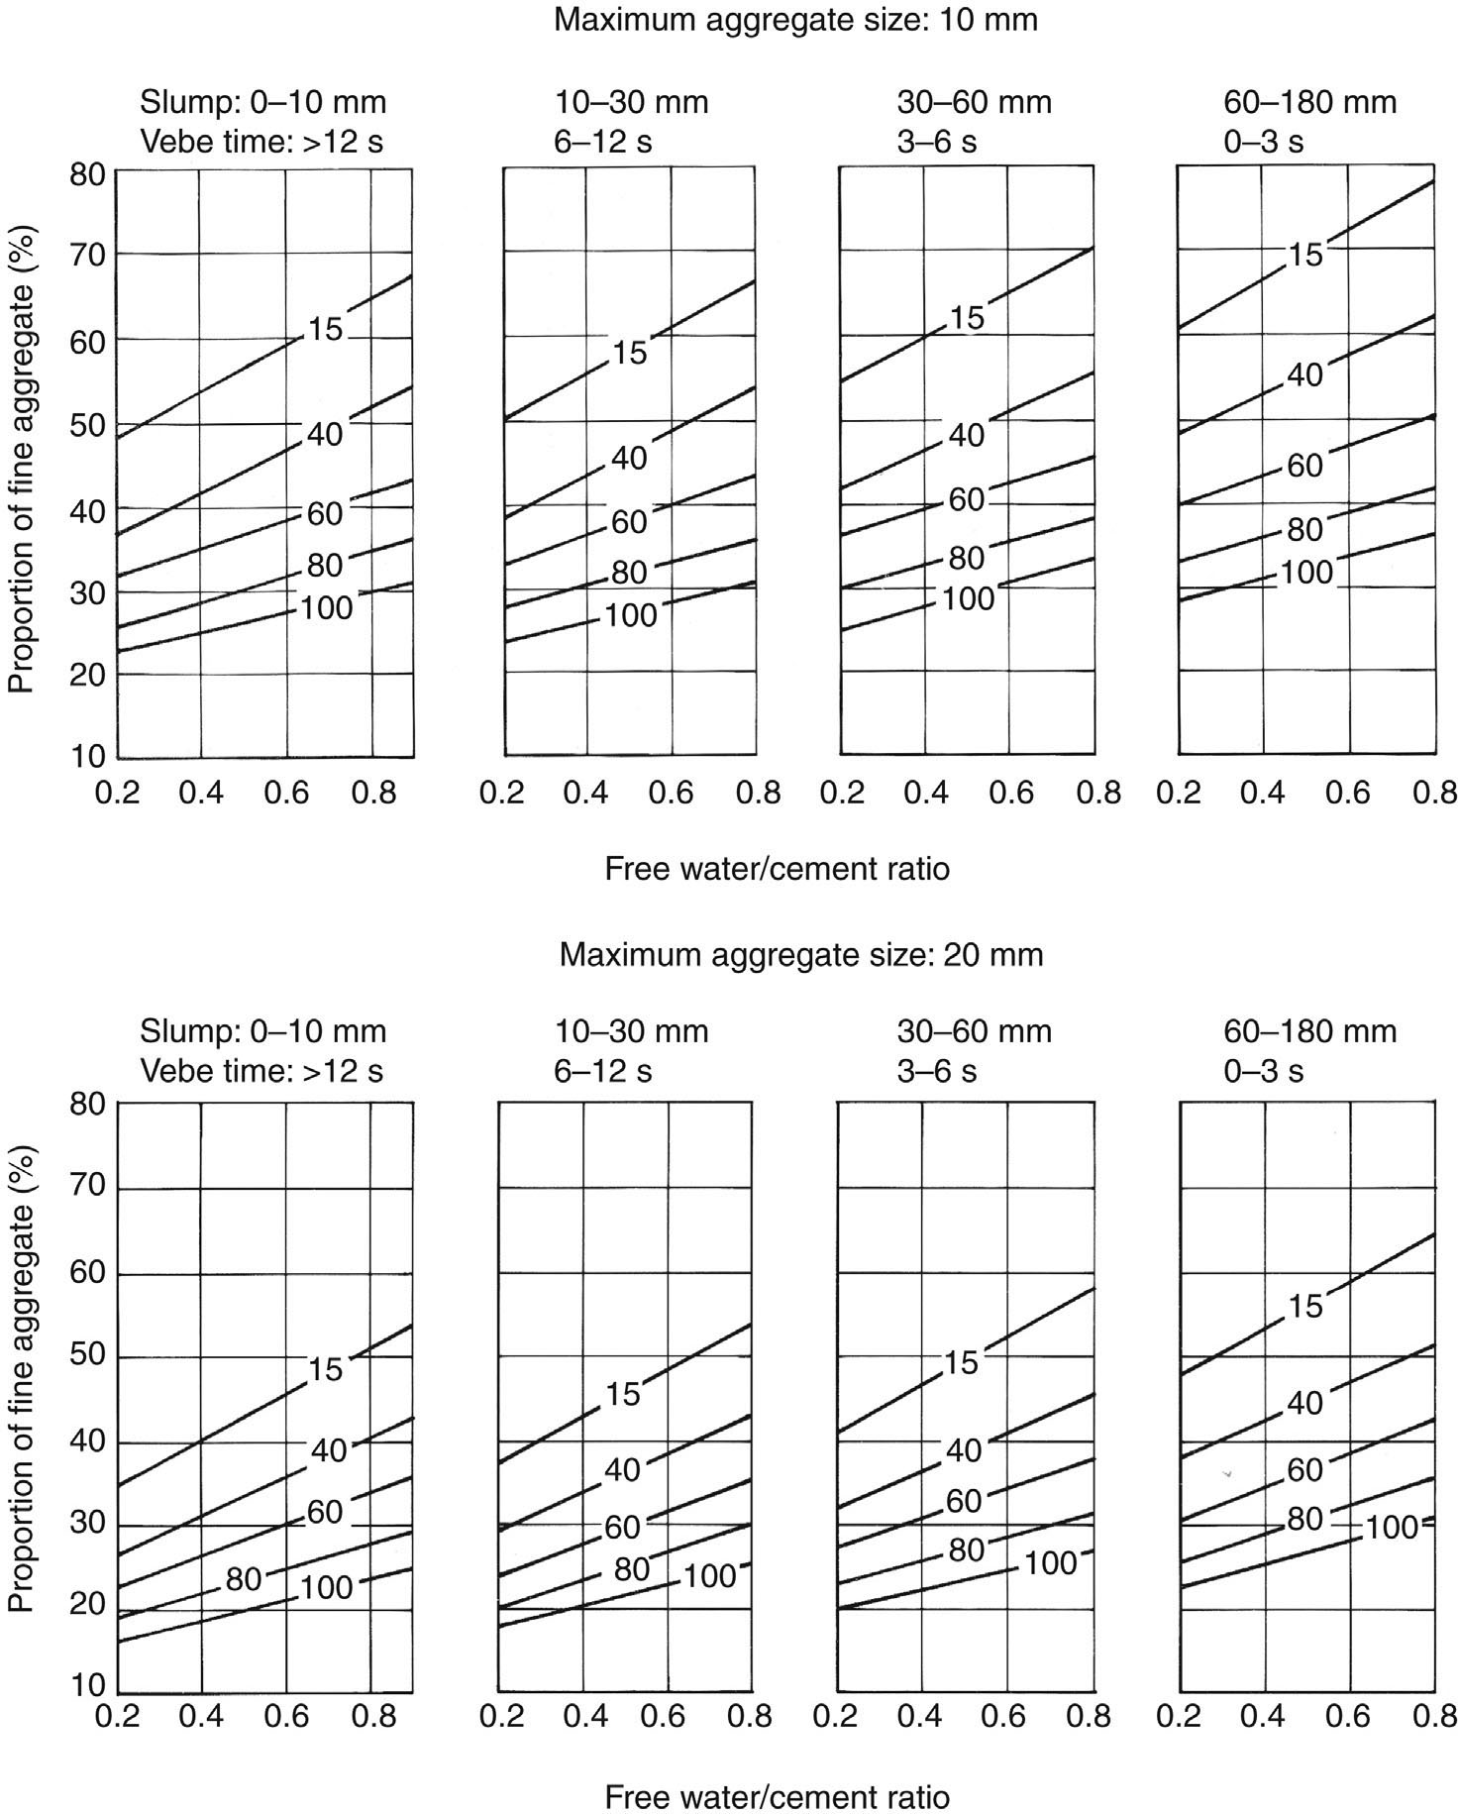
FIGURE 21.4 Relationship Between Proportion of Fine Aggregate and w/c Ratio

Slide 5
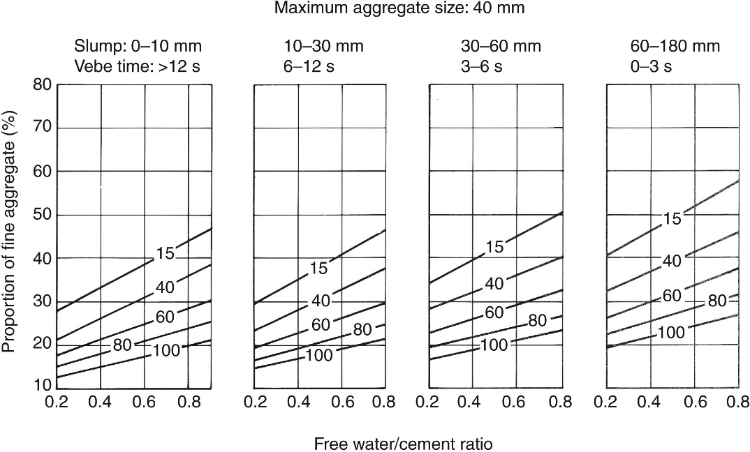
FIGURE 21.4 (cont.)

Slide 6
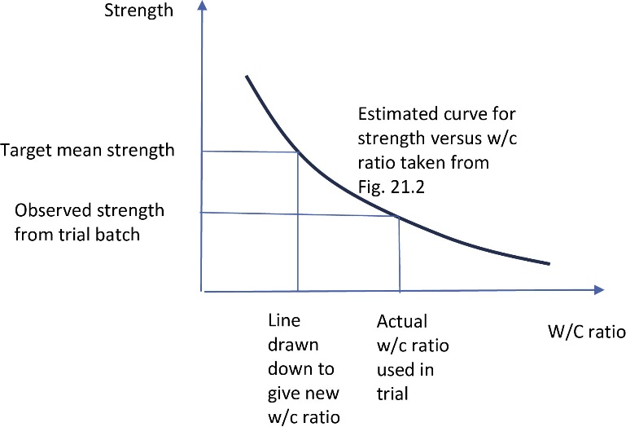
FIGURE 21.5 Mix Redesign

Slide 7
